Slide 1

FUTURE GROUP: A STUDY ON ITS DOWNFALL

Slide 2
Introduction
Future Group is an Indian conglomerate.
The company is known for having a significant prominence in various sectors, with an established supermarket chains.
The group also has a notable presence in integrated foods and FMCG manufacturing sectors.
Future Retail Limited and Future Lifestyle Fashions Limited, two operating companies of Future Group.

Slide 3




Company of Future Group
FMCG
FASHION
RETAIL
OTHERS

Slide 4

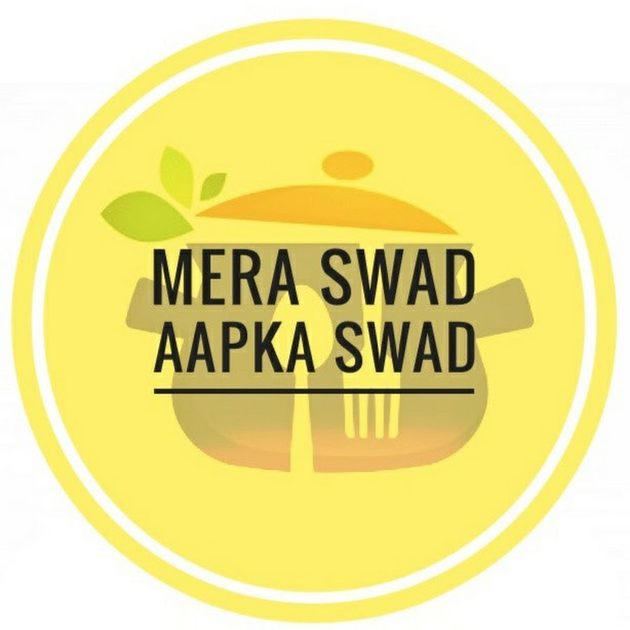



FMCG
Fast-moving consumer goods are products that are sold quickly and at a relatively low cost.
Future group is presently in every fmcg product ranging from biscuits , snacks to aata & grains.
Sub brands such as tasty treat The brand is present in many ready-to-eat indulgence categories, from biscuits to namkeens, beverages, sauces and even more.
CareMate offers a wide range of toiletries such as facial tissues, toilet tissues, aluminum foils, cling films, handwashes and their product reflect the philosophy in their quality, functionality, and packaging.
Veg Affaire offers a range of frozen vegetables and sweet corn kernels, which offers you the freshness of farm-like vegetables. Veg Affaire believes in making vegetarianism appealing.

Slide 5



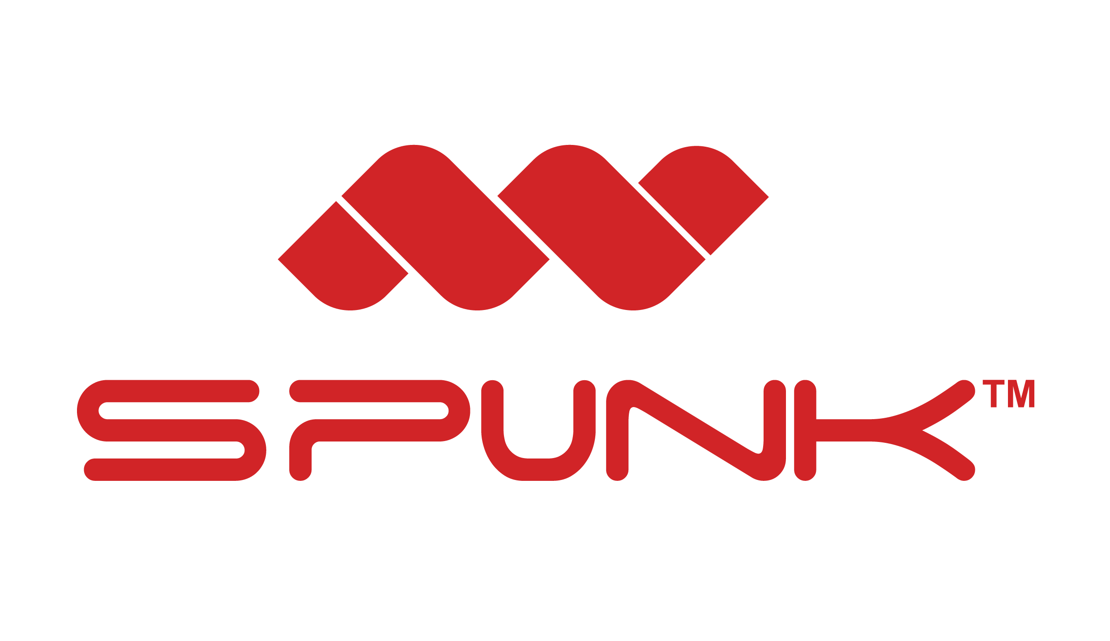

FASHION
Fashion is a form of self-expression and autonomy at a particular period and place and in a specific context, of clothing, footwear, lifestyle, accessories, makeup, hairstyle, and body posture.
Buffalo David Bitton is an iconic lifestyle brand that translates across international boundaries.it is a global fashion brand offering a strong denim collection along with a complete assortment of apparel and accessories.
Fashion Rig is a finest fashion store with wide range of Indian Ethnic Wear. India's most trusted and loved web store which carter all your clothing needs.
Fashion Spunx is an active wear brand of future group.

Slide 6
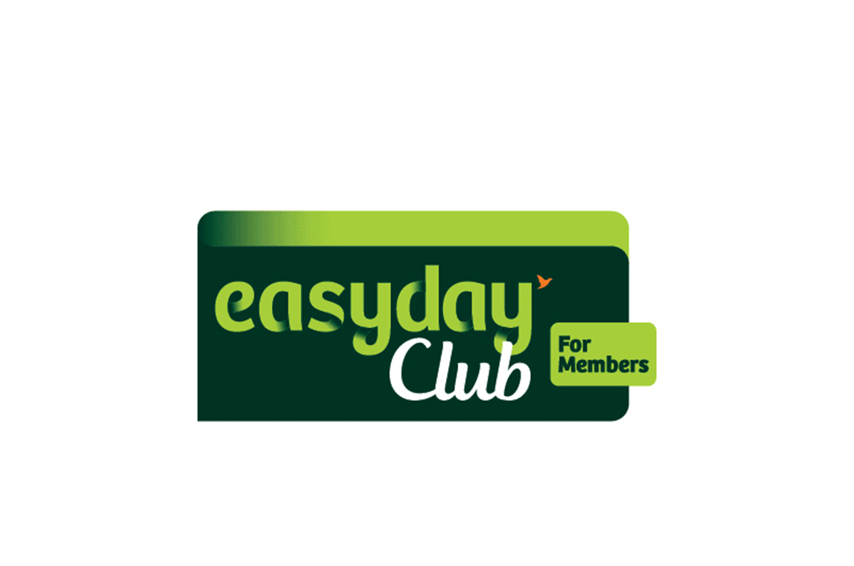




RETAIL
India is the fifth-largest retail destination globally. Country's retail sector is experiencing exponential growth with retail development taking place not just in major cities and metros, but also in tier II and III cities
Easyday is an Indian retail brand that runs chains of consumer retail supermarkets and convenience stores.
Nilgiri's is a supermarket chain in South of India. It is also one of the oldest supermarket chains in India with origins dating back to 1905. It also has a store brand & produces dairy and other products under the same name.
Central and Brand Factory are the two prominent brands of clothing industry.
Big Bazaar is an Indian retail chain of hypermarkets, discount department stores, and grocery stores.

Slide 7

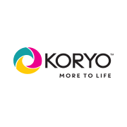

OTHERS
Future group also entered various other
Sector exclusive of retail &
fast moving Consumer goods.
Future group also entered insurance sector
named as
Future Generali Total Insurance.
In real estate named as Future Group Reality
In steel utensils and electronics sector
with a name of Koryo.

Slide 8
Reasons of downfall of group

Slide 9

Taking wrong strategic decision.
futurebazaar.com.
Future general group.
Movie production.
Demerging of the companies.

Slide 10
Taking debt year after year
Source : futuregroup.com
Notes:
Annual reports of companies

Slide 11
Continuous loss
Source :Future Retail Profit and Loss Reports - The Economic Times (indiatimes.com)
Notes:
Future Retail Profit and Loss Reports - The Economic Times (indiatimes.com)

Slide 12


Buying many brands

Slide 13

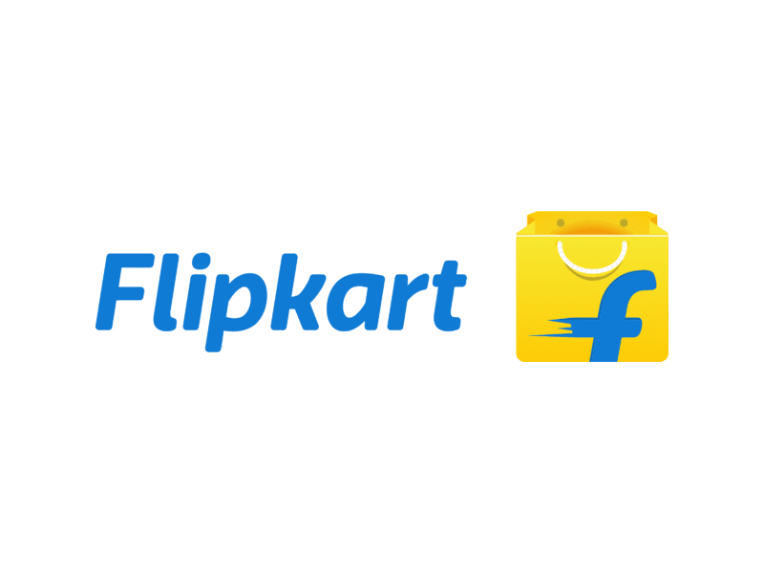
Not standing against competition
Flipkart Ecommerce giant gaining great presence.
No online store.
Discontinue approach to ecommerce.

Slide 14


Deal with different companies at wrong terms and conditions
Not be able to sell stake of company to other without permission.
No selling of stake to competition.
Large stake of company sold to one company.
Notes:
1500CR deal

Slide 15

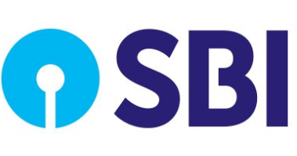
Future group membership card and Sbi partnerships

Slide 16
Our Interpretation
Company should watch their profits regular before expanding.
Should not enter in sector , in which they don’t have expertise.
Always work with competition , not against them.
Majority stake of company should not be sold to one organization or company.

Slide 17
THANK YOU

